Slide 1
Heart Disease Data Analysis Continuous - Model Comparison & PCA
GR5293 Project II
Presented by:
Ningxin Xu (nx2160),
Hongwei Chen (hc3272),
Gaochong Tan (gt2459)

Slide 2
Data Description
BMI : Body Mass Index (BMI).
Smoking : Have you smoked at least 100 cigarettes in your entire life? (Convert ‘yes’ into 1 and ‘no’ into 0.)
Stroke : Ever told you had a stroke? (Convert ‘yes’ into 1 and ‘no’ into 0.)
PhysicalHealth : Now thinking about your physical health, which includes physical illness and injury, for how many days during the past 30 days was your physical health not good? (0-30 days).
DiffWalking : Do you have serious difficulty walking or climbing stairs?
Sex : Are you male or female? (Convert Male to 1, Female to 0)
AgeGroup: Convert into 4 groups: 18 - 34 = 0 ; 35 - 49 = 1 ; 50 - 64 = 2; 64 - older = 3
KidneyDisease : Not including kidney stones, bladder infection or incontinence, were you ever told you had kidney disease? (Convert ‘yes’ into 1 and ‘no’ into 0.)
SkinCancer : (Ever told) (you had) skin cancer?
Notes:
The dependent variable (y) is a binary variable, heart disease with all predictors here

Slide 3
In the previous project…
Exploratory data analysis: AgeGroup may be the most important variable affecting heart disease
Fitting logistic regression model: the accuracy has reached 0.91 with auc of 0.816

Slide 4
Potential Improvement…
Try different models: such as Gradient Boosting, Decision Tree, or Random Forest to figure out the optimal model
Dimensionality reduction: apply PCA into our predictors to see whether we can use less dimensions into the optimal model
Model interpretation: which factor influence heart disease most? How people should notice in their daily life?

Slide 5
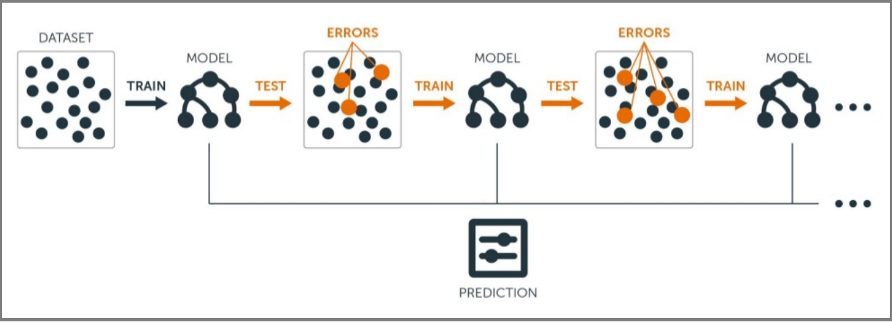
Gradient Boosting Classifier
“whether a weak learner could be modified to be better in the next level, while remaining the existing model unchanged and minimizing the overall errors after adding the new features.”

Slide 6
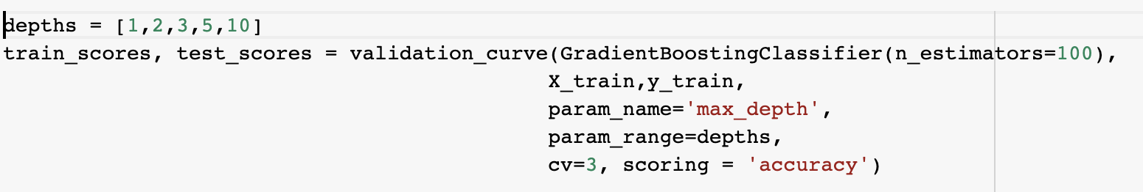
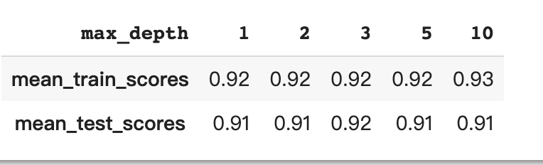
Applying Gradient Boosting Classifier on training data
We used validation curve to find the best max depth here which provides the best train and test score.
The highest mean test score is 0.92 corresponding to max_depth = 3.

Slide 7
Applying Gradient Boosting Classifier on training data
We fit the GBC model with n_estimator = 100, max_depth = 3 and set the random_state as 123
From the model, the mean cv accuracy is: 0.915 with its standard error of 0.001
The test accuracy using test data is 0.916

Slide 8
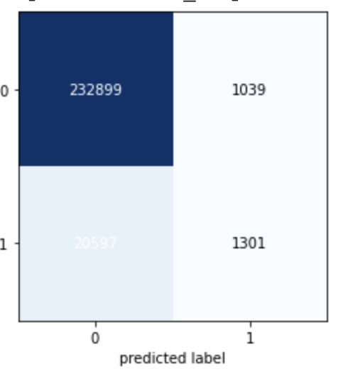
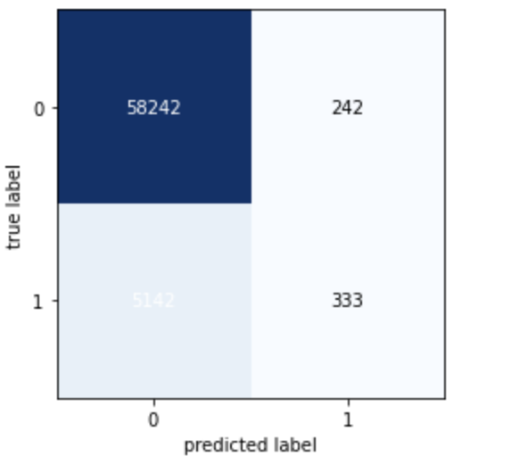
GBC Confusion Matrix
TPR = TP/P = 1301/(1301+20597) = 0.059
FPR = FP/N = 1039/(1039+232899) =0.004
TPR = TP/P = 333/(333+5142) = 0.061
FPR = FP/N = 242/(242+58242) =0.004
Training model
Test model
AUC = 0.82, larger than what we got from the Logistic regression model.

Slide 9
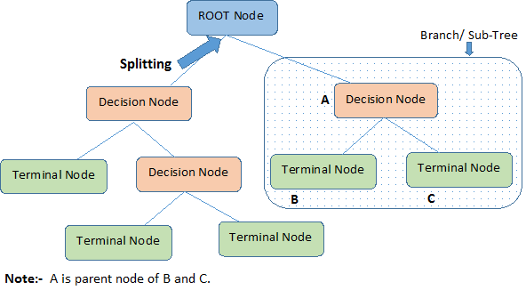
Decision Tree Classifier
“is known as its tree-like structure, which contains decision nodes and leaves: beginning with the root node, the decision nodes are where the data splits and the leaves are the final outcomes, just as the figure below represents”

Slide 10
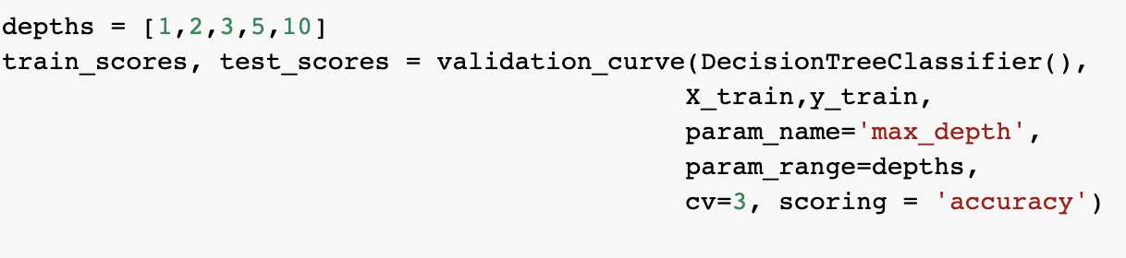
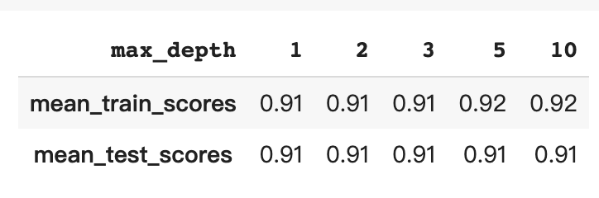
Applying Decision Tree Classifier on training data
We also used validation curve to find the best max depth here which provides the best train and test score.
Since the test scores are same in all depth, we decided to use the depth providing best training score with the least cose, which is 5.

Slide 11
Applying Decision Tree Classifier on training data
We fit the DTC model with max_depth = 5 and set the random_state as 123
From the model, the mean cv accuracy is: 0.915 with its standard error of 0.000
The test accuracy using test data is 0.92

Slide 12
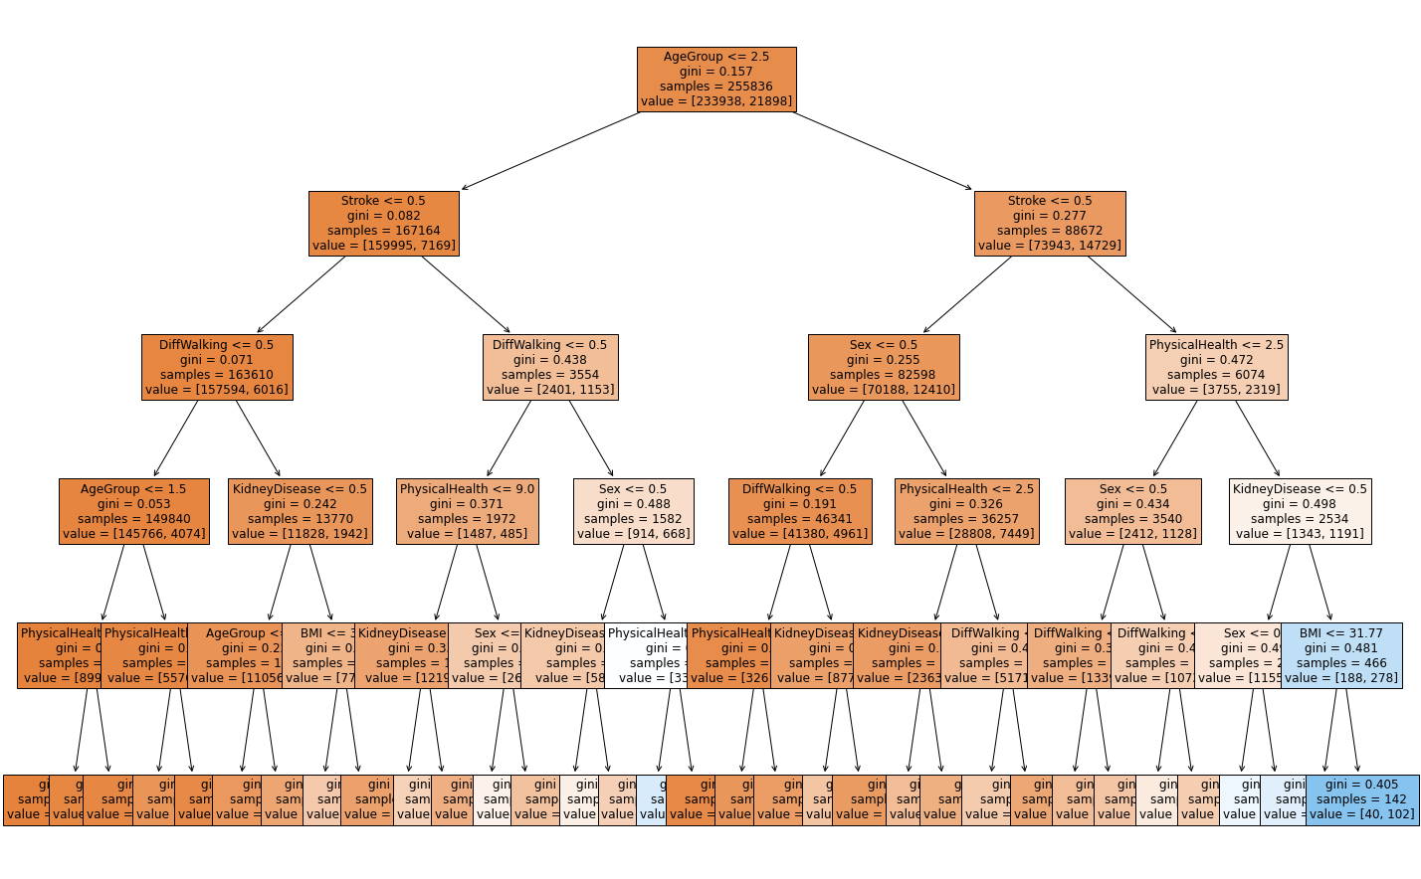
Decision Tree Classifier Model
Notes:
Brief look of the model

Slide 13
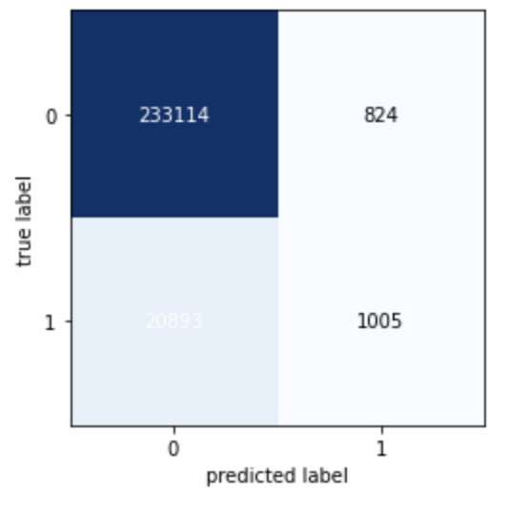
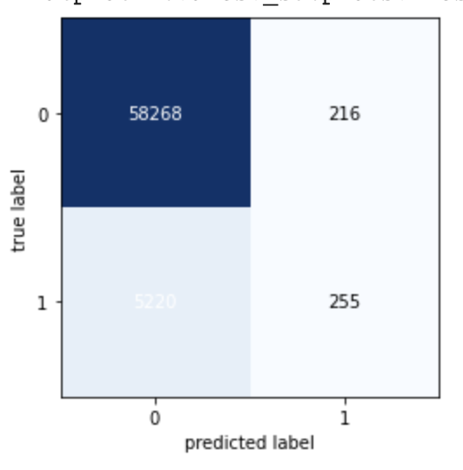
DTC Confusion Matrix
TPR = TP/P = 1005/(1005+20893) = 0.046
FPR = FP/N = 824/(824+233114) = 0.004
TPR = TP/P = 255/(255+5220) = 0.047
FPR = FP/N = 216/(216+58268) = 0.004
Training model
Test model
AUC = 0.80, smaller than the AUC for the previous gbc model and the logistic regression model.

Slide 14
Model Comparison
Logistic Regression Classifier
Gradient Boosting Classifier
Decision Tree Classifier

Slide 15
Accuracy Comparison
Mean CV accuracy on training data:
LRC: 0.915 +- 0.001
GBC: 0.915 +- 0.001
DTC: 0.915 +- 0.000
Test accuracy:
LRC: 0.915
GBC: 0.916
DTC: 0.92
From those statistics, we could found these three models all perform very well and the difference is tiny.

Slide 16
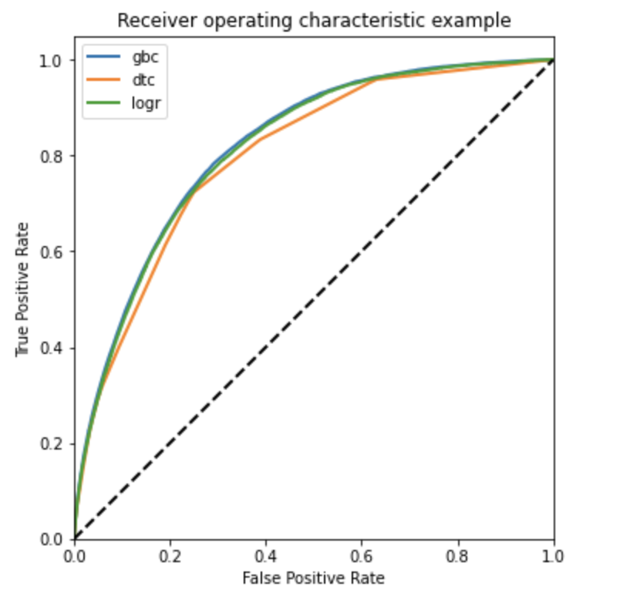
Accuracy Comparison
We plot the ROC curves in one plot
The AUC values are:
LRC: 0.816
GBC: 0.820
DTC: 0.800
GBC has the highest AUC, which its ability of distinguishing between the positive and negative classes is better.
→ Gradient Boosting Classifier is the best model here!

Slide 17
Dimensionality Reduction
Principal Components Analysis

Slide 18
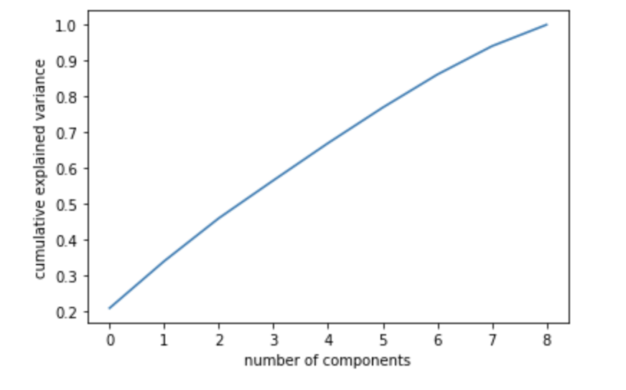
Choosing n_components
We want the variance explained at least reaches 75% to make the interpretation easier.
Thus, we choose n_components = 7, which could explains more than 90% variance in this graph.

Slide 19
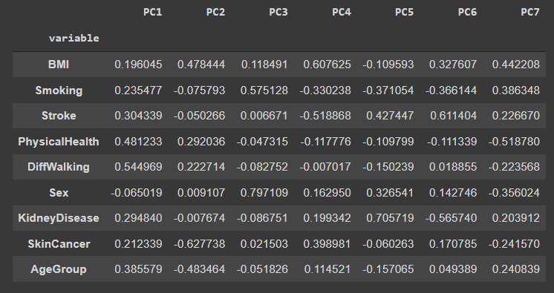
PCA Components
Notes:
The components in the PCA with each variable

Slide 20
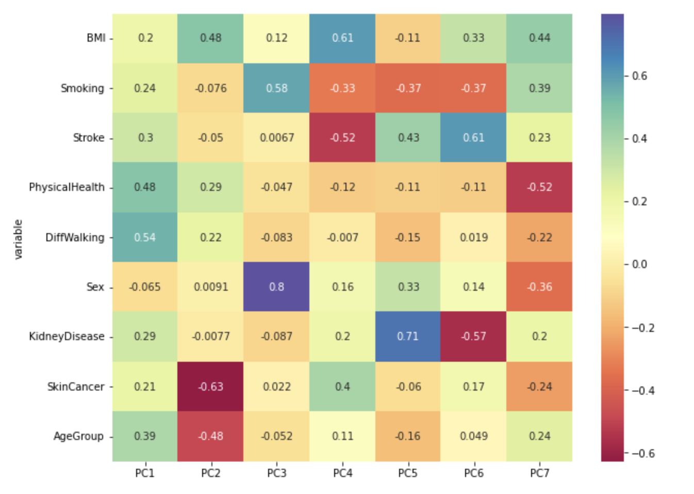
PCA Components
Positive and negative values in component loadings reflects the positive and negative correlation of the variables with the PCs.
For example, except Sex, all other variables have positive projection on first PC.
Notes:
The heatmap of correlations between each variable and pcs. We can see PhysicalHealth in PC1, SkinCancer inPC2, Smoking and Sex in PC3, BMI, Stroke in PC4, KidneyDisease in PC5… are significant. Hence, we need to care more about these factors in our daily life to prevent heart disease.

Slide 21
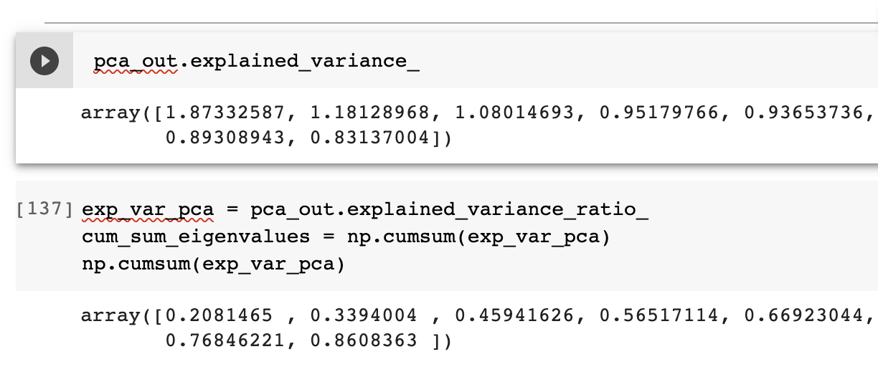
PCA Explained Variance
The eigenvalues (variance explained by each PC) for PCs can help to retain the number of PCs. Generally, PCs with eigenvalues > 1 contributes greater variance and should be retained for further analysis.
In our analysis, the highest PC only explains 20% and our whole pca data only explains 86%.

Slide 22
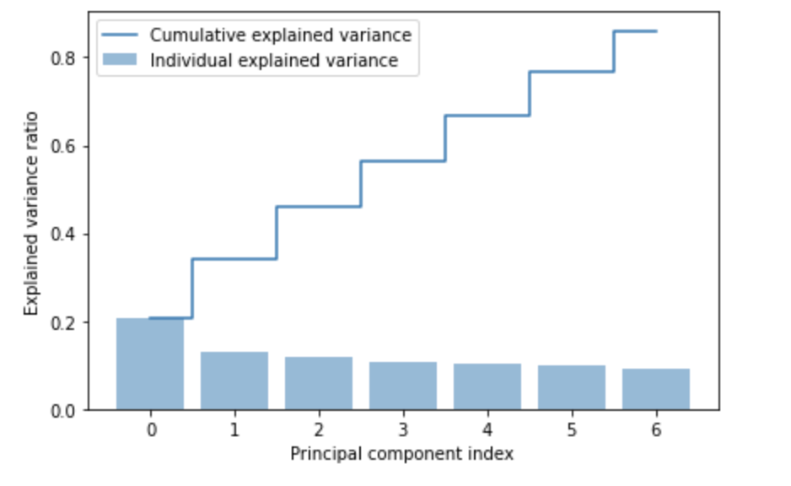
PCA Explained Variance
Every PC explains less than 30% of variance. We originally have 9 features.
Now we can only reduce 2 dimensions using PCA.
Hence, applying PCA to our model might not change a lot.

Slide 23
GBC Model Interpretation
With Original Data
With PCA data
* We use feature_importances_ attribute to calculate the values of feature importances.

Slide 24
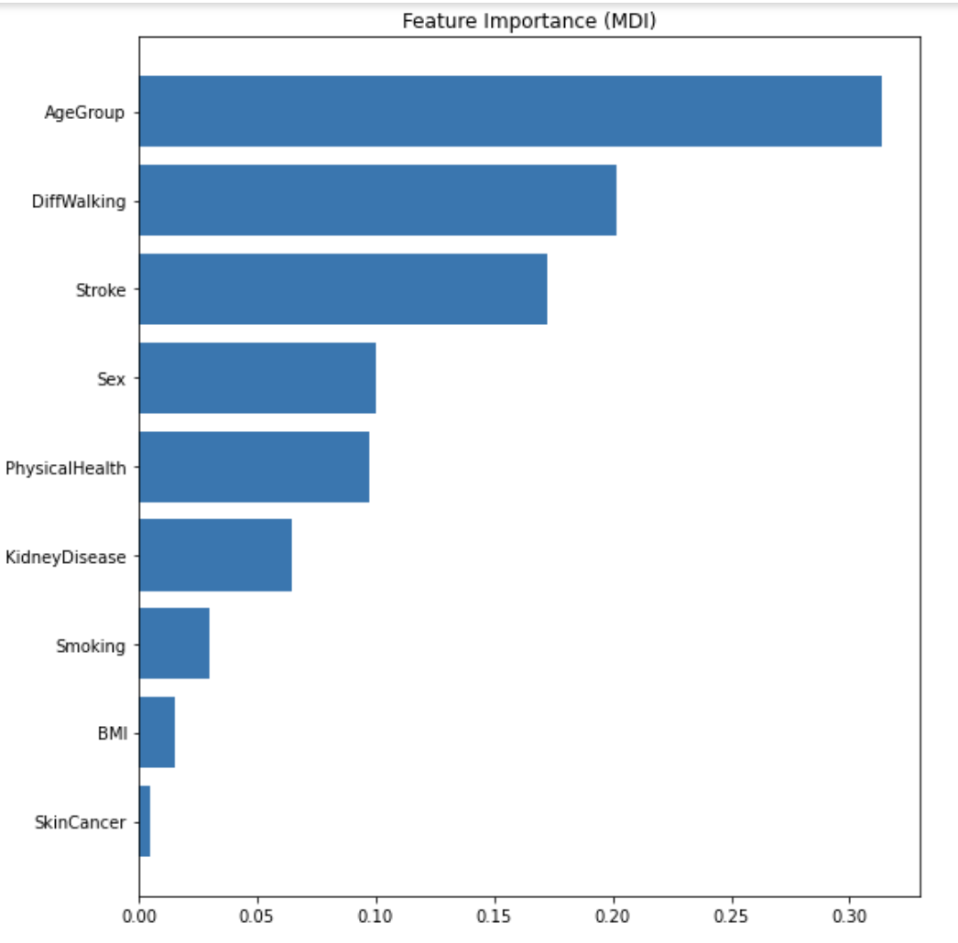
GBC Model With Original Data
The ‘AgeGroup’ occupies 30% or more importance in this model; ‘DiffWalking’ and ‘Stroke’ also have more than 15% of importance
‘AgeGroup’, ‘DiffWalking’ and ‘Stroke’ are the top three important features.
Notes:
可以解释一下这三个variable是什么:
Stroke : Ever told you had a stroke? (Convert ‘yes’ into 1 and ‘no’ into 0.)
DiffWalking : Do you have serious difficulty walking or climbing stairs?
AgeGroup: Convert into 4 groups: 18 - 34 = 0 ; 35 - 49 = 1 ; 50 - 64 = 2; 64 - older = 3

Slide 25
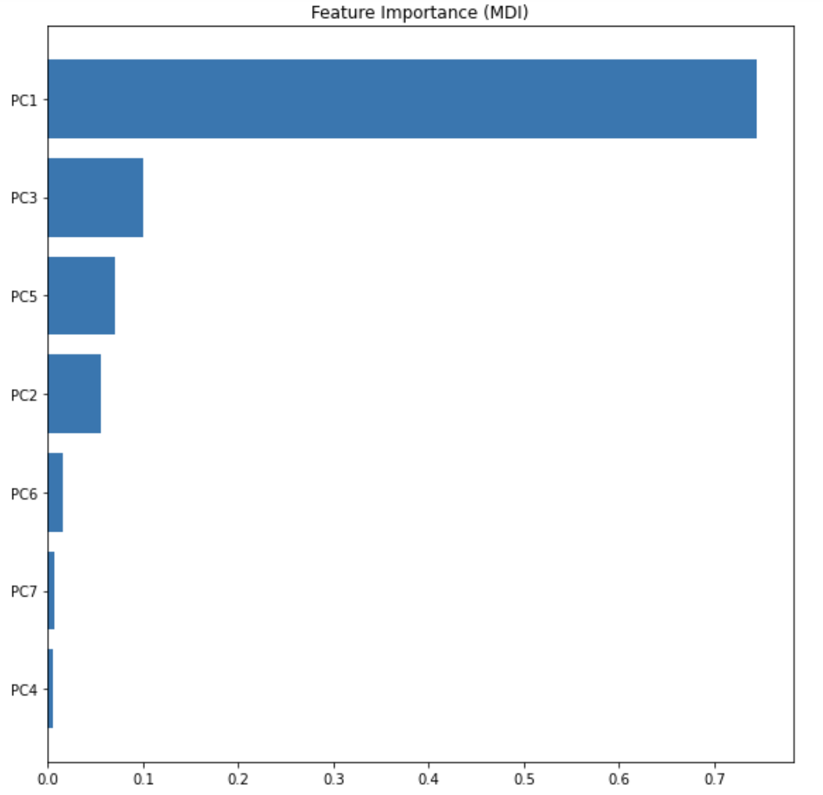
GBC Model With PCA Data
PC1 is the vital feature in this model, which has a importance over 70%.
From the heatmap, ‘DiffWalking’, ‘PhysicalHealth’ and ‘Agegroup’ have the highest correlation with PC1.
This model using PCA data gives similar result with the model using original data.
Notes:
PhysicalHealth : Now thinking about your physical health, which includes physical illness and injury, for how many days during the past 30 days was your physical health not good? (0-30 days).

Slide 26
Conclusion & Suggestions
Age can be a main indicator of heart disease, so while getting ages, people need to do physical examination regularly.
The signal of difficulty in walking or climbing stairs is also significant. If people suffer this problem in daily life, they should consult doctor for suggestion on physical activity to avoid myocardial infarction.
Stroke is dangerous. people who have ever stroke should be more careful on their heart health.

Slide 27
Q&A?
Thank you for your patience!

